Slide 1
A Closer Look at Few-shot Classification
Wei-Yu Chen Yen-Cheng Liu & Zsolt Kira Yu-Chiang Frank Wang Jia-Bin Huang
ICLR 2019
Presented by HaoHui Ye
SCUT Machine Intelligence Laboratory
Jan 18, 2022

Slide 2
Contents
1
Background
2
Motivation
3
Proposed Method
4
Experimental Results
5
Conclusion

Slide 3
Contents
1
Background
2
Motivation
3
Proposed Method
4
Experimental Results
5
Conclusion

Slide 4
Background
The problem of learning to generalize to unseen classes during training, known as few-shot classification, has attracted considerable attention
Examples include model initialization based methods, metric learning methods and hallucination based methods.

Slide 5
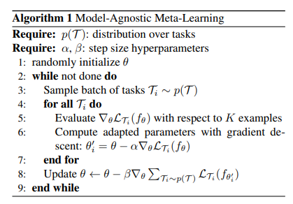
Background
Initialization based methods：tackle the few-shot learning problem by “learning to fine-tune”. One approach aims to learn good model initialization (i.e., the parameters of a network) so that the classifiers for novel classes can be learned with a limited number of labeled examples and a small number of gradient update steps.
Representative Model: MAML^{[1]}
[1] Model-agnostic meta-learning for fast adaptation of deep networks. Chelsea Finn, Pieter Abbeel, and Sergey Levine.

Slide 6
Background
Distance metric learning based methods.
Hallucination based methods: directly deal with data deficiency by “learning to augment”. GAN

Slide 7
Contents
1
Background
2
Motivation
3
Proposed Method
4
Experimental Results
5
Conclusion

Slide 8
Motivation
While many few-shot classification algorithms have reported improved performance over the state-of-the-art, there are two main challenges that prevent us from making a fair comparison and measuring the actual progress.
First: the discrepancy of the implementation details.
Second: lack of domain shift between the base and novel classes.

Slide 9
Contents
1
Background
2
Motivation
3
Methods
4
Experimental Results
5
Conclusion

Slide 10
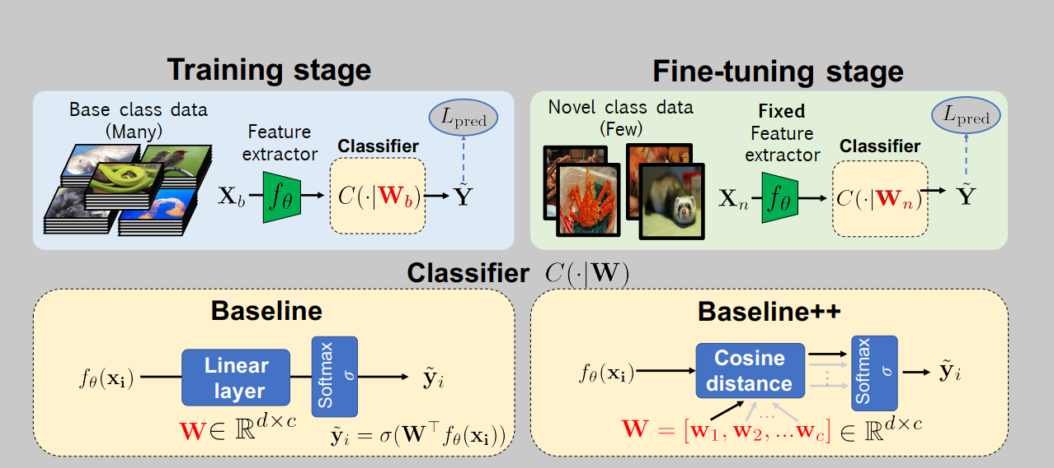
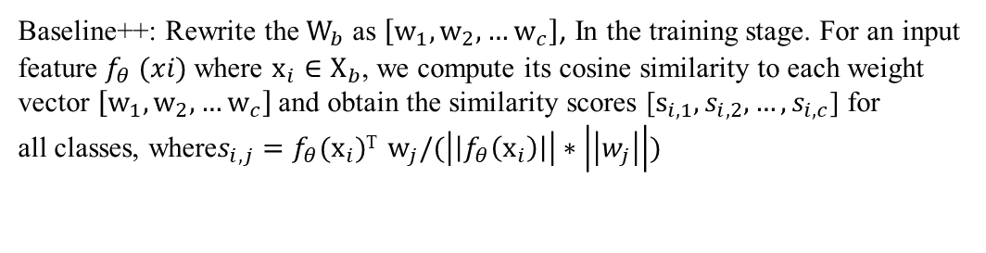
Methods
Baseline and Baseline++
Baseline++: Rewrite the $W_{b}$ as $\left[w_{1},w_{2},…w_{c}\right]$, In the training stage. For an input feature $f_{θ} (xi)$where $x_{i}∈X_{b}$, we compute its cosine similarity to each weight vector $\left[w_{1},w_{2},…w_{c}\right]$and obtain the similarity scores [$s_{i,1},s_{i,2},…,s_{i,c}$] for all classes, where$s_{i,j}=f_{θ}(x_{i})$^{T} $w_{j}/(\left|\left|f_{θ}\left(x_{i}\right)\right|\right|∗\left|\left|w_{j}\right|\right|)$

Slide 11
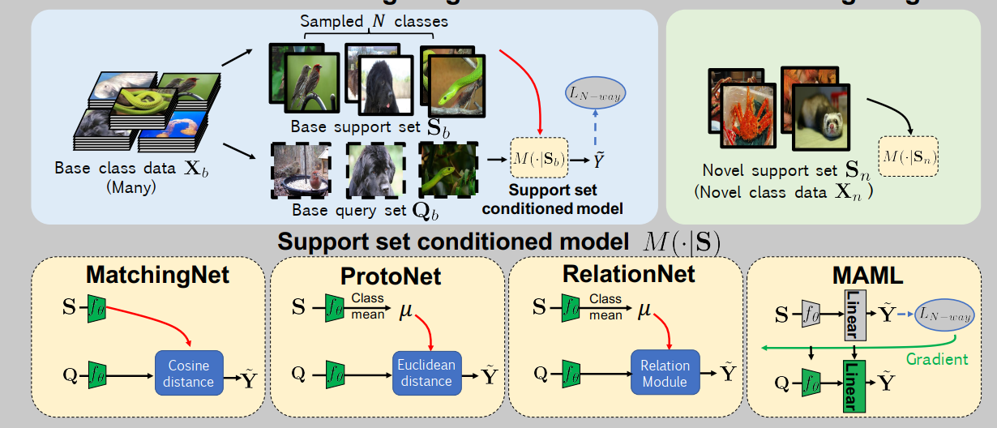
Methods
Meta-Learning Algorithm

Slide 12
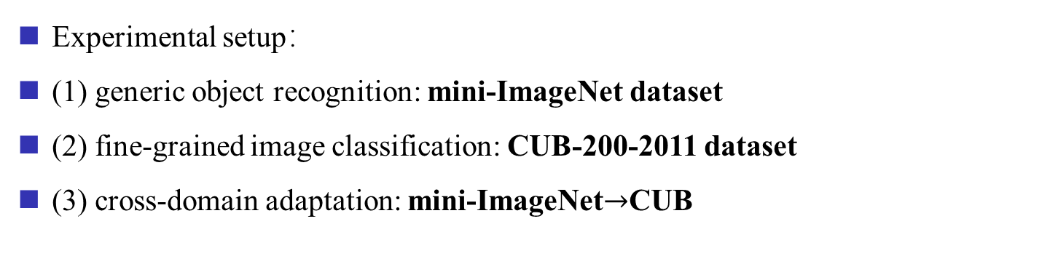
Methods
Experimental setup：
(1) generic object recognition: mini-ImageNet dataset
(2) fine-grained image classification: CUB-200-2011 dataset
(3) cross-domain adaptation: mini-ImageNet$→$CUB
Details:
In the training stage for the Baseline and the Baseline++ methods, we train 400 epochs with a batch size of 16.
In the meta-training stage for meta-learning methods, we train 60,000 episodes for 1-shot and 40,000 episodes for 5-shot tasks.
All methods use Adam optimizer

Slide 13
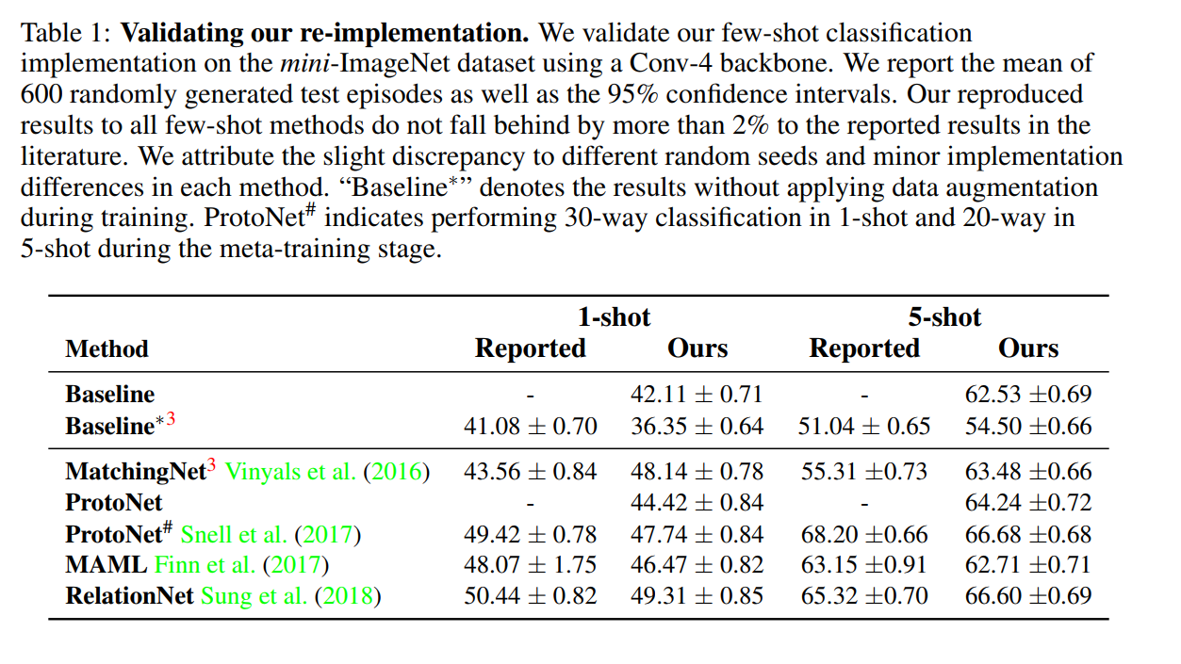
Methods
Experiment 1:evaluation using the standard setting.
Some methods get improved under modifications.
The performance of the Baseline method is severely underestimated

Slide 14
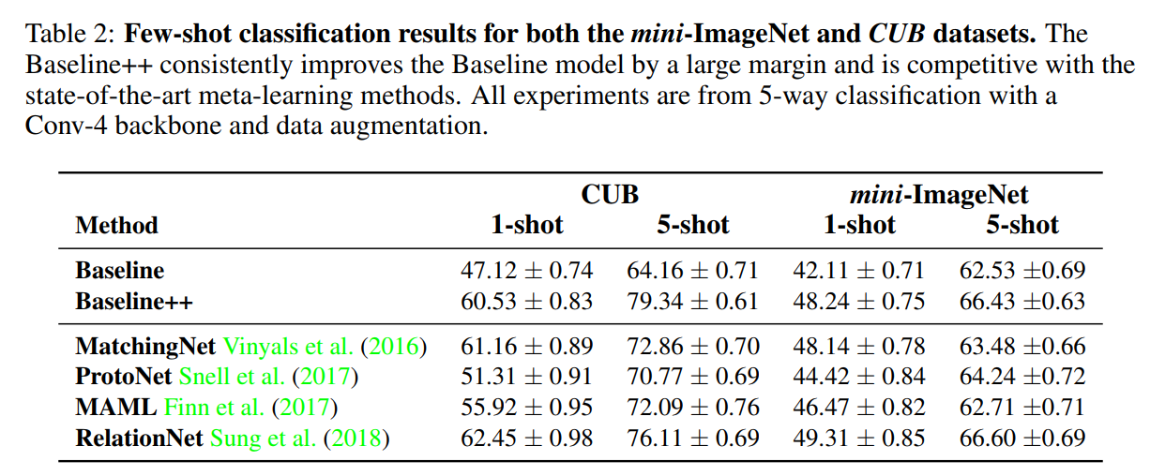
Methods
Experiment 1:evaluation using the standard setting.
The performance of baseline++ demonstrate that reducing intra-class variation is an important factor in the current few-shot classification problem setting.

Slide 15
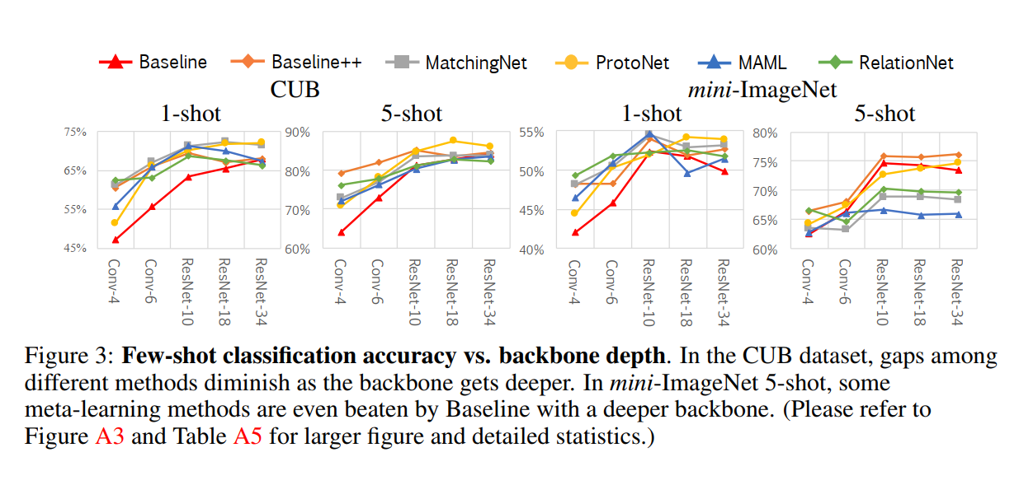
Methods
Experiment 2:Effect of increasing the network depth
①In the CUB dataset, the gap among existing methods would be reduced if their intra-class variation are all reduced by a deeper backbone.
Notes:
在CUB中，Matching Net和Proto Net都表现不俗，可能是他们需要比较少的参数，在网络变深的时候减少了过拟合的出现。

Slide 16
Methods
Experiment 2:Effect of increasing the network depth
②However，the result in mini-ImageNet shows that :other than intra-class variation, the dataset is also important in few-shot classification.
Notes:
在CUB中，Matching Net和Proto Net都表现不俗，可能是他们需要比较少的参数，在网络变深的时候减少了过拟合的出现。
②中，CUB和mini-ImageNet的不同点在于他们的class不同,mini-image的class 比较多

Slide 17
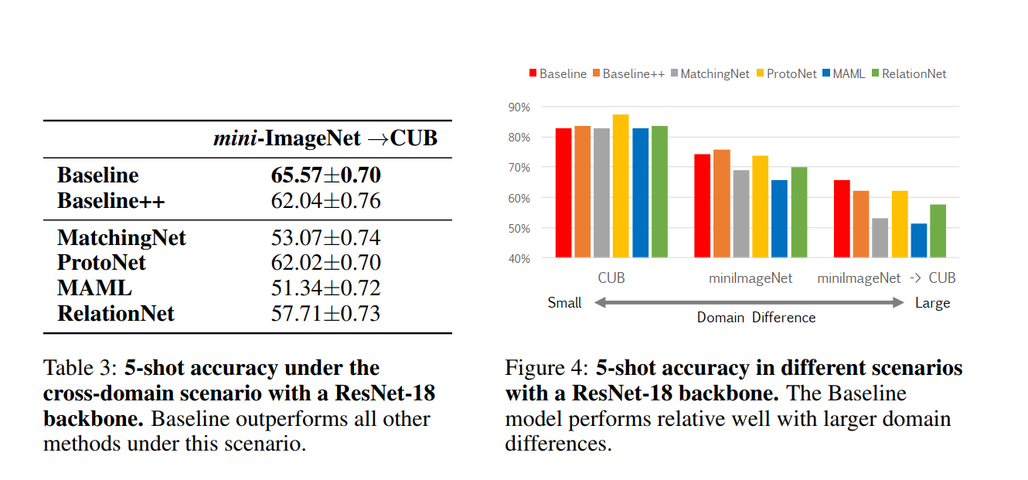
Methods
Experiment 3:Effect of domain differences between base and novel classes
As the domain difference grows larger, the adaptation based on a few novel class instances becomes more important.

Slide 18
Methods
Improvement：Apply further adaptation
An intuitive way to improve the problem of domain shift is that enhance the ability of domain adaptation. So for:
MatchingNet and ProtoNet: fix the features and train a new softmax classifier.
MAML: hard to add adaptation to the initialization method, so update the parameters for as many iterations as is required to train a new classification layer as in baseline and baseline in their fine-tune stage.

Slide 19
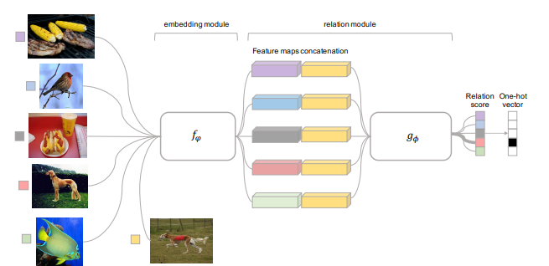
Methods
RelationNet: the features are convolution maps(embedding module) rather than feature vectors, so it can not be replace with a softmax, and train the parameters. As an alternative, we randomly split the few training data in novel class into 3 support and 2 query data to finetune the relation module for 100 epochs.
[2] Learning to Compare: Relation Network for Few-Shot Learning. Flood Sung, Yongxin Yang, Li Zhang, Tao Xiang, Philip HS Torr, and Timothy M Hospedales.

Slide 20
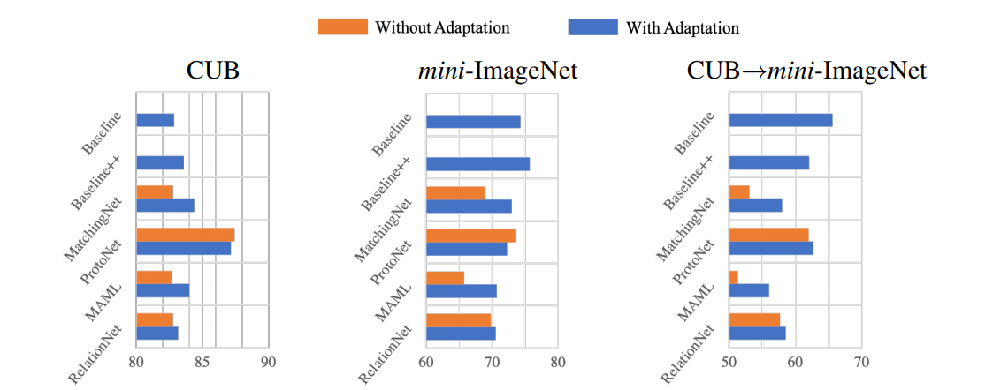
Methods
Meta-learning methods with further adaptation steps.
Result shows that learning to learn adaptation in the meta-training stage would be an important direction for future meta-learning research in few-shot classification.

Slide 21
Contents
1
Background
2
Motivation
3
Proposed Method
4
Experimental Results
5
Conclusion

Slide 22
Conclusion
Through comparing methods on a common ground, our results show that the Baseline++model is competitive to state of art under standard conditions,
The Baseline model achieves competitive performance with recent state-of-the-art meta-learning algorithms on both CUB and mini-ImageNet benchmark datasets when using a deeper feature backbone.
Surprisingly, the Baseline compares favorably against all the evaluated meta-learning algorithms under a realistic scenario where there exists domain shift between the base and novel classes.
Adding domain adaptation can improve the performance on few-shot learning task with domain shift.

